Slide 1
Dependable Distributed Systems
Master of Science in Engineering in Computer Science
AA 2026/2027
Lecture 13: Total Order Broadcast

Slide 2
System model
Static set of processes Π = {p₁ … p_{n}}
Message passing over perfect channels
  i.e., message exchanged between correct processes are reliably delivered
Asynchronous
Crash fault model for processes
We characterize the system in terms of its possible runs R
TOcast(m)
TOdeliver(m)
R
r
m
p₁
m
p₂
m
p_{n}
crash

Slide 3
TO specifications
Total order specifications are usually composed by four properties
Validity: guarantees that messages sent by correct processes will eventually be delivered
Integrity: guarantees that no spurious or duplicate messages are delivered
Agreement: imposes constraints on the set of messages to be delivered
Order: imposes constraints on the sequence of messages to be delivered

Slide 4
TO specifications
Total Order Broadcast = TO(V,I,A,O)
  V = Validity
  I = Integrity
  A = Agreement
  O = Order
Distinct specifications arise from distinct formulations of each property
  uniform vs non-uniform
  A uniform property imposes restrictions on the behavior of (at least) correct processes

Slide 5
TO specifications
Total Order Broadcast = TO(V,I,A,O)
  V = Validity
  I = Integrity
  A = Agreement
  O = Order
TO Broadcast
Integrity
Uniform
Non-uniform
Validity
Uniform
Agreement
Ordering
Non-uniform
Uniform
Non-uniform
Uniform
Non-uniform
All
Correct Processes
All
Correct Processes
All
Correct Processes
All
Correct Processes

Slide 6
TO Specifications
Crash failure + Perfect channels ⇒
  NUV: if a correct process TOCAST a message m then some correct process will eventually deliver m
  UI: For any message m, every process p delivers m at most once and only if m was previously TOCAST by some (correct or not) process

Slide 7
TO specifications
Total Order Broadcast = TO(V,I,A,O)
  V = Validity
  I = Integrity
  A = Agreement
  O = Order
Distinct specifications arise from distinct formulations of each property
  uniform vs non-uniform
  A uniform property imposes restrictions on the behavior of (at least) correct processes
NUV
UI
TO(A,O)

Slide 8
The Agreement property
Uniform Agreement (UA)
Non-uniform Agreement (NUA)
  If a process (correct or not) TODelivers a message m, then all correct processes will eventually TODeliver m
If a correct process TODelivers a message m, then all correct processes will eventually TODeliver m
Constrains the set of delivered messages
  Correct processes always deliver the same set of messages M
  Each faulty process p delivers a set M_{p}
    UA: M_{p} ⊆ M
    NUA: M_{p} can be s.t. M_{p} - M ≠ ∅

Slide 9
The Agreement property
Uniform Agreement (UA)
Non-uniform Agreement (NUA)
  If a process (correct or not) TODelivers a message m, then all correct processes will eventually TODeliver m
If a correct process TODelivers a message m, then all correct processes will eventually TODeliver m
m₄
m₂
m₃
m₁
m₄
m₂
m₃
m₁
p₁
p₁
m₁
m₂
m₃
m₄
m₁
m₂
m₃
m₄
UA
p₂
p₂
NUA
m₁
m₄
m₃
m₁
m₅
m₄
m₃
p₃
m₂
p₃

Slide 10
The Ordering Property
Strong Uniform Total Order (SUTO)
Weak Uniform Total Order (WUTO)
If some process TODelivers some message m before message m’, then a process TODelivers m’′ only after it has TODelivered m.
  same order
  same prefix of the set of delivered messages
  after an omission, disjoint sets of delivered messages
  If process p and process q both TODdeliver messages m and m′, then p TODelivers m before m′ if and only if q TODdelivers m before m′.
    no restrictions on the set of delivered messages

Slide 11
The Order Property
Strong Uniform Total Order (SUTO)
Weak Uniform Total Order (WUTO)
If some process TODelivers some message m before message m′, then a process TODelivers m′ only after it has TODelivered m.
  If process p and process q both TODdeliver messages m and m′, then p TODelivers m before m′ if and only if q TODdelivers m before m′.
m₁
m₂
m₃
m₆
m₁
m₂
m₃
m₆
p₁
p₁
m₁
m₂
m₃
m₇
m₁
m₃
m₇
SUTO
p₂
p₂
WUTO
m₁
m₂
m₄
m₅
m₁
m₂
m₄
m₅
p₃
p₃

Slide 12
The Order Property
SUTO and WUTO are uniform but they both have a non-uniform counterpart
Strong Non-uniform Total Order (SNUTO)
Weak Non-uniform Total Order (WNUTO)
If some correct process TODelivers some message m before message m′, then a correct process TODelivers m′ only after it has TODelivered m.
If correct processes p and q both TODeliver messages m and m′, then p TODelivers m before m′ if and only if q TODelivers m before m′.

Slide 13
The Order property (2)
SUTO ⇒ WUTO
SNUTO ⇒ WNUTO
m₁
m₂
m₃
m₆
p₁
m₁
m₂
m₃
m₇
SNUTO
p₂
m₂
m₁
m₄
m₅
p₃
m₁
m₂
m₃
m₆
p₁
m₁
m₂
m₃
m₇
WNUTO
p₂
m₂
m₁
m₄
m₅
p₃

Slide 14
TO specifications
m₁
m₂
m₃
m₆
p₁
m₁
m₂
m₃
m₆
p₂
m₁
m₂
p₃
TO(UA,SUTO)
  The strongest TO spec.
TO(NUA,SUTO)
TO(UA,SUTO)
(Strongest
total order)
m₁
m₂
m₃
m₆
p₁
m₁
m₂
m₃
m₆
p₂
m₁
m₂
m₄
m₅
TO(NUA,SUTO)
p₃

Slide 15
TO specifications (2)
m₁
m₂
m₃
m₄
TO(UA,SUTO)
(Strongest
total order)
p₁
m₁
m₂
m₃
m₄
TO(UA,WUTO)
p₂
m₁
m₂
m₃
m₄
p₃
TO(UA,WUTO)
TO(NUA,SUTO)
m₁
m₂
m₃
m₄
m₆
TO(NUA,WUTO)
p₁
m₁
m₂
m₃
m₄
m₆
TO(NUA,WUTO)
p₂
m₁
m₃
m₄
m₅
m₆
m₂
p₃

Slide 16
TO specifications (3)
TO(UA,WNUTO)
TO(UA,SUTO)
(Strongest
total order)
m₁
m₂
m₃
m₄
p₁
m₁
m₂
m₃
m₄
TO(UA,WUTO)
TO(NUA,SUTO)
p₂
m₁
m₂
m₄
m₃
p₃
TO(NUA,WNUTO)
TO(UA,WNUTO)
TO(NUA,WUTO)
m₁
m₂
m₃
m₄
m₆
p₁
m₁
m₂
m₃
m₄
m₆
TO(NUA,WNUTO)
p₂
m₁
m₄
m₃
m₅
m₆
m₂
p₃

Slide 17
Total Order Implementation
TOBroadcast(m)
TODeliver(s_{m}, m)
Total Order
Broadcast
rbDeliver(s_{m}, m)
rbBroadcast(m)
propose(s_{n}, list)
decide(s_{n}, list)
Reliable
Broadcast
Consensus

Slide 18
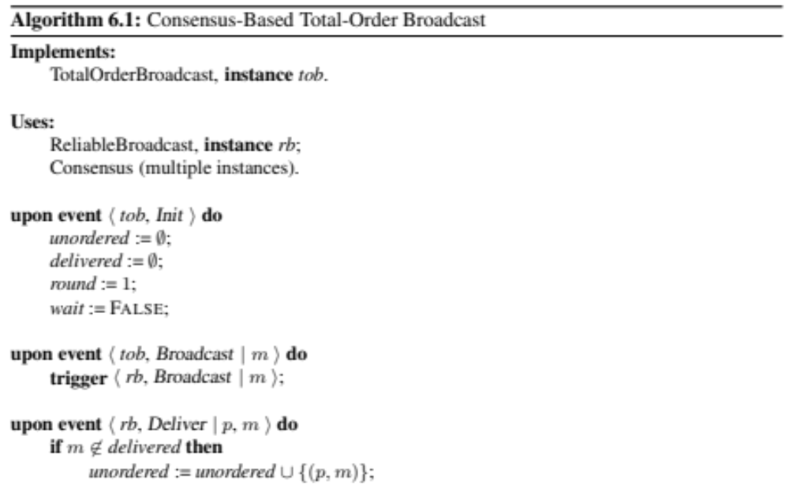
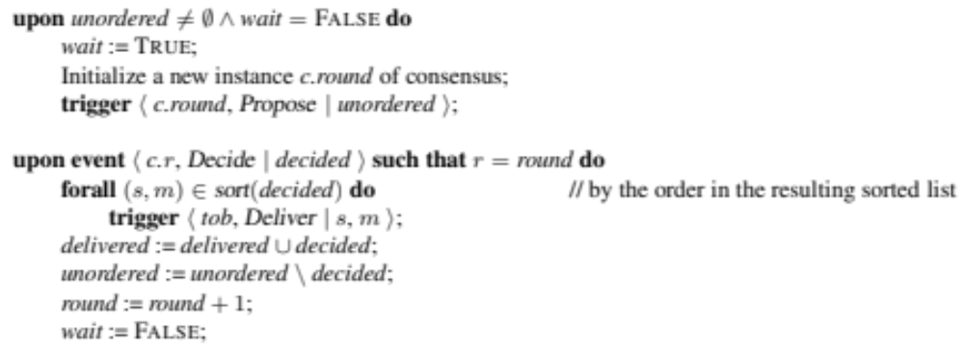
Total Order Algorithm

Slide 19
Example
m1
p1
p2
p3
p4
m2
An instance of consensus is triggered

Slide 20
Example
m1
m1
p1
p2
m2
p3
m1
p4
m1, m2
m2
Each process proposes its unordered buffer

Slide 21
Example
m1
p1
p2
p3
m1
p4
m2
Consensus return m1 and all processes deliver m1

Slide 22
Example
m1
m2, m3
p1
m2, m3
p2
m3
m2
p3
m4
m2
p4
m2
An instance of consensus is triggered
Each process proposes its unordered buffer

Slide 23
Example
m1
p1
p2
m3
p3
m4
p4
m2
Consensus return m2, m3 and all processes deliver m2 and then m3

Slide 24
Exercice
Which TO specification is satisfied by this algorithm?
It depends from the assumptions about Reliable Broadcast and Consensus
Consensus Reliable Broadcast | Uniform | Non Uniform
Uniform
Non Uniform

Slide 25
Example 1 (UC and URB)
m1
m2
m3
m4
p1
m1
m2
m3
p2
m1
m2
m3
m4
p3
m1
m2
m3
m4
p4
Consensus 1
Delivery 1
Consensus 2
Delivery 2
Consensus 3
Delivery 3

Slide 26
Example 2 (UC and URB)
m1
m2
m3
m4
p1
m1
m2
p2
m1
m2
m3
m4
p3
m1
m2
m3
m4
p4
Consensus 1
Delivery 1
Consensus 2
Delivery 2
Consensus 3
Delivery 3

Slide 27
Uniform Consensus (UC) and
Uniform Reliable Broadcast (URB)
Assuming both Consensus and Reliable Broadcast uniform we have
TO (UA, SUTO)
Proof.
  Due to URB all the processes (even the faults) deliver the same set of messages
  The unordered buffer contains the same set of messages for each process
    All the processes will deliver the same set of messages (UA)
  Due to UC, all processes (even the faults) decide for the same list of messages
  Messages are sorted by a deterministic rule
    All processes will deliver the messages in the same order

Slide 28
Example (NUC and URB)
m1
m3
m2
m4
p1
m1
m2
m3
p2
m1
m3
m2
m4
p3
m1
m3
m2
m4
p4
Consensus 1
Delivery 1
Consensus 2
Delivery 2
Consensus 3
Delivery 3

Slide 29
Non Uniform Consensus (NUC) and
Uniform Reliable Broadcast (URB)
Assuming both Consensus and Reliable Broadcast uniform we have
TO (UA, WNUTO)
Proof.
  Due to URB all the processes (even the faults) deliver the same set of messages
  The unordered buffer contains the same set of messages for each process
    All the processes will deliver the same set of messages (UA)
  Due to NUC, all correct processes decide for the same list of messages
  Faulty processes can decide differently
    All correct processes will deliver the messages in the same order
    Faulty processes will deliver, just before a crash, a different sequence of messages

Slide 30
Example (NUC and NURB)
m1
m4
m3
m5
p1
m1
m2
m3
m4
p2
m1
m4
m3
m5
p3
m1
m4
m3
m5
p4
Consensus 1
Delivery 1
Consensus 2
Delivery 2
Consensus 3
Delivery 3
Consensus 4
Delivery 4

Slide 31
Non Uniform Consensus (NUC) and
Non Uniform Reliable Broadcast (NURB)
Assuming both Consensus and Reliable Broadcast uniform we have
TO (NUA, WNUTO)
Proof.
  Due to NURB correct processes deliver the same set of messages
  Faulty processes can deliver other messages
    Only correct processes will deliver the same set of messages (NUA)
  Due to NUC, all correct processes decide for the same list of messages
  Faulty processes can decide differently
    All correct processes will deliver the messages in the same order
    Faulty processes will deliver, just before a crash, a different sequence of messages

Slide 32
Consensus Reliable Broadcast | Uniform | Non Uniform
Uniform | UA SUTO | UA WNUTO
Non Uniform |  | NUA WNUTO
Exercice
Which specification is satisfied assuming UC and NURB?

Slide 33
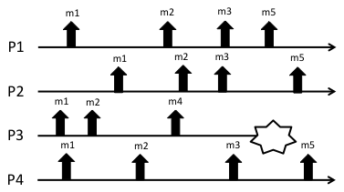
Exercice
Consider the run depicted in the figure:
Which type of total ordering is satisfied by the run? Specify both the agreement and the ordering properties.
Modify the run in order to satisfy TO(UA, WUTO) but not TO (UA SUTO)
Modify the run in order to satisfy TO(NUA, WNUTO) but not TO(NUA, WUTO)

Slide 34
References
C. Cachin, R. Guerraoui and L. Rodrigues. Introduction to Reliable and Secure Distributed Programming, Springer, 2011
  Chapter 6 – Section 6.1
Stefano Cimmino, Carlo Marchetti, Roberto Baldoni ”A Guided Tour on Total Order Specifications” WORDS Fall 2003: 187-194

